Slide 1
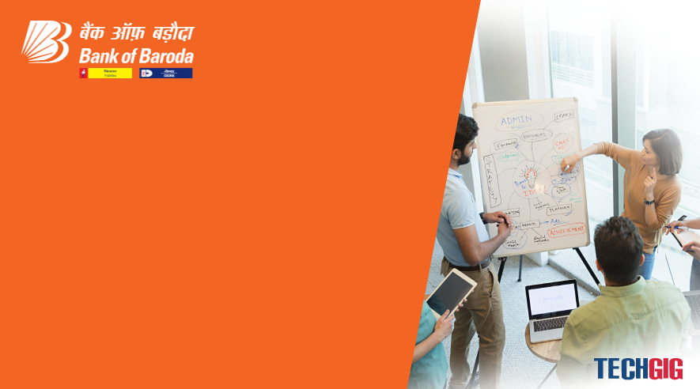

Bank of Baroda Hackathon - 2022
Technology Partner
Team Name : Neoteric
Liquidators
Your team bio : Always ready to fire
Date : 19/09/2022

Slide 2
Problem Statement?
Why did you decide to solve this Problem statement?
We decided to solve this because:
We want to make the banking process fully digital.
To curb and reduce the processing time to few seconds.
Humans are too best but due to few members , the transparency lags.
And for our education expenses.

Slide 3
Cheque Format of our project.
for(int i=
0;i<10;i++)
Payer account details in ASCI codes
Bank name
ASCI Date stamper
Funds. :. Multiples
1,00,00,000. :
10,00,000. :
1,00,000. :
10,000. :
1,000. :
100. :
10 :
Payee ___________________________________________
Account number : ***************
Payee fingerprint
impression
Payer fingerprint
Impression

Slide 4
Working Principle
ATCVM
Cheque
Cash
Or transferred to account
ATCVM: Automatic cheque,cash vending machine
When the cheque’s inserted in that ATCVM machine
It will recognise the fingerprint impression and read the funds details with the help of Optical Mark Recognition (OMR).
When the details are matched and verified with bank data base, then the cash are dispensed.

Slide 5
ATCVM consists:
Adhaar data base
OMR n openCV Other
Recognition Devices
ATCVM
Bank Data base
And other electronic n mechanical sources of machine to run it

Slide 6
Working algorithm:
On insertion of cheque
Firstly verification of date.
secondly it will recognise the funds details as filled in that omr Block.
with the help of Aadhar data base the fingerprint impressions are verified.
Payer Account details are detected by openCV tech(source link provided at the last).
Account details are compared with payer fingerprint impression With both data bases . If matched n success
Then, the fingerprint of payee is matched with the bank data base.
Then all account Numbers Of payee are displayed Along with the option of cash.
He/she, now can choose Any option, and with respect to the option ,the cash transferred to di payee account number or cash are dispensed at that instant.
Just before the 8th step a physical verification Of fingerprint is done ✅ . To check whether it matches with payee details of cheque.(where a third person can’t draw a cheque, security enhanced).
Payee name block added for the general enquiry purpose if any error found, a assistance(employee of bank) will be provided to him. And after all verification the assistance have rights to dispense cash from that machine after logged in, When the machine fails to perform that function .

Slide 7
Working flowchart
F
Insert
Date verify
F
Omr verify
Fingerprint verification
F : false/fail
F
Display options
Physical verify
F
Cash
Exit

Slide 8
Prototype:
Build prototype
Requirement
Gathering
Customer evaluation Of prototype
Quick Design
Refine according to customer suggestion
Design
Implementation
Test
Maintenance

Slide 9
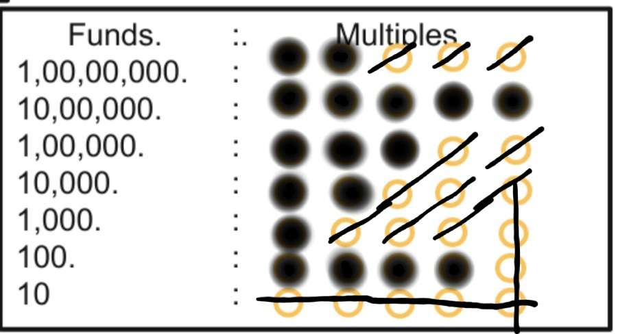
OMR filling type
For eg : for
Two crore fifty three lakh twenty one thousand Four hundred
This eg block can explain all details
Where ever there is perfect circle that is counted, and those sticked out of the circle not considered.

Slide 10
Alternate ideas:
Alternate to cash: The machine can generate a receipt,with the help of it the user can withdraw funds from counter after all verification done by officer.

Slide 11
Frauds
Due to fingerprint impression there’s 100% verification , rather then sign verification, because it can’t have 100% and the sign can be copied.
So in that fingerprint there is 0% risk.
If the payee tries to mark those other unfilled circles of OMR then The Machine will not dispense any cash , Because it had been stricken Off with long line out of the circle, and for investigation the cheque will be sent to the counter.
If any condition not meet then , for further assistance a member will check and pass the cheque.
If any error found a complaint can be raised.

Slide 12
Microsoft Azure services lists:
Azure cosmos DB – for the API service ,to link bank with machine.
Active directory – for login purpose, to login in his account with help of fingerprint.(like AEPS)
Azure data lake – for the storage of transaction details, like funds details along with client Photoshoot.
Signal IR – for the live support if they don’t understand the use age of machine.
IOT
And other services will be added based on customer’s feedbacks.

Slide 13
Source links:
(Which lead to generate idea)
OpenCV idea : https://www.hindawi.com/journals/acisc/2020/8535861/
OMR : https://en.m.wikipedia.org/wiki/Optical_mark_recognition

Slide 14
Why do you want to select our project?
Easy accessible , no language issues .
Everyone can use our methods even if they Have Little Knowledge.
It will save the bank’s lot of money and time.
It is more secure and less time consuming compared to previous methods.
It make’s banking easy by allowing instant cash transfer or instant cash withdrawal.
Hello 👋
Don/Dona,
“If you raise funds to our project we are capable of building it”
Along with your live support.
🙏

Slide 15
Thank You
Team member names
👏🙏 Support of all ,our Dedicated Teacher’s
Hari om Mali
Abilash R Ramesh
Abdul naeim
Sathya.

